Slide 1
PROJECT ON
BOSTON HOUSE PRICING
PRESENTATION BY AKILESHWARAN

Slide 2
1
INRTODUCTION

Slide 3
IMPORTANT
AGENDA

Slide 4




100%
THE CLIENT IS A CITY COUNCIL OF BOSTON, MA WHO SHARED THEIR ANNUALLY COLLECTED HOUSE DATA FOR ANALYSIS.
80%
HE WANTS TO KNOW WHICH FACTOR DECREASED THE HOUSING PRICE IN BOSTON.
65%
60%
40%
10%
20%
RECOMMENDATIONS THAT COULD HELP TO INCREASE THEIR SELLING PRICE FOR THE NEXT FEW YEARS.

Slide 5
PROCESS FLOW FOR ANALYSIS
BUSINESS ANALYSIS
Deeply analysing the background process of the business to avoid assumptions.
DATA SUMMARY
Knowing the statistical information about the data’s that has been shared.
DATA CLEANSING
Analysing the data thoroughly to remove the missing values or to impute them with mean ,median or mode values of the colum.
DATA VISUALIZATION
Data has been transformed to scatter plots, bar charts and histogram to have better analysis structures.
INFERECING
After the analysis with the help of statistical tools , we now found some pros and cons in the business process.
REPORT & MODELLING
All the observations are then created as a report for final presentation of the model.

Slide 6
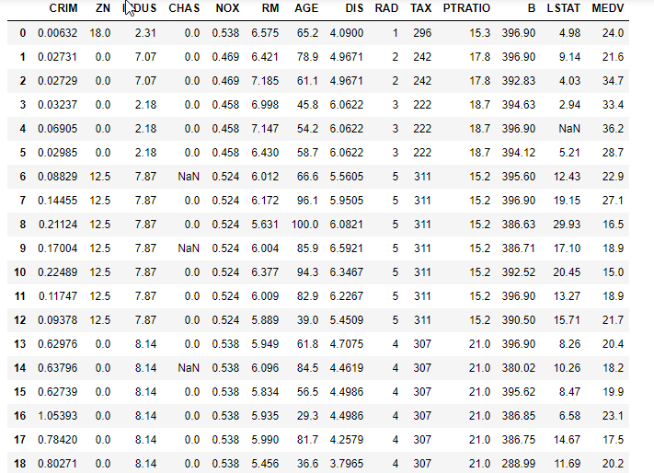
OVERVIEW OF THE DATA

Slide 7
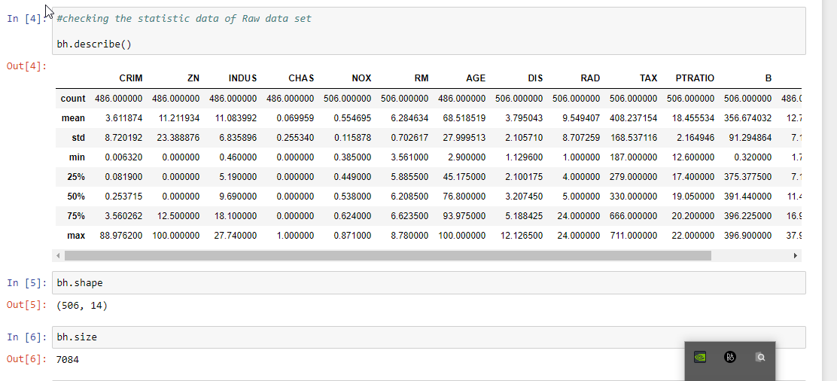
SUMMARY STATISICS OF THE DATA

Slide 8
CONTENT ANALYSED FROM DATA
MISSING DATA
OUTLIERS
IMPUTATIONS
From the analysis we came to know that 1.69% of data is been missing entirely.
Outliers are irrelevant values that has been entered in the columns. Very few outliers are spotted using box plots and the columns are transformed.
For the missing values in the data, the entire column have been imputed with the mean values in place of ‘Nan’ and 0’s.

Slide 9
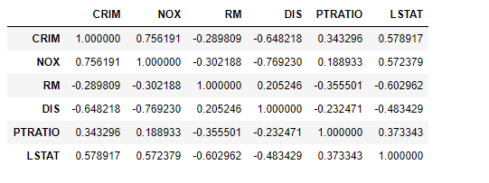
Your Slide Title
The data set contained 13 independent variables.
‘MEDV’ is the only dependent variable.
‘CRIM , PTRATIO , RM , LSTAT , NOX , DIS’ are considered as the target variables.

Slide 10
Idea Concept
CO-LINEARITY
NEGATIVELY SKEWED
FROM THE PREVIOUS SLIDE WE CAN SEE THE TARGET VARIABLES ARE NOT HIGHLY CORRELATED WITH EACH OTHER.
MOST OF THE VARIABLES ARE NEGATIVELY CORRELATED.
MEDV AS PRICING
TESTING AND TRAINING
DATA AHS BEEN EVALUTED AND TRAINED.
HERE LETS SAY THE VARIABLE ‘MEDV’ AS PRICE FOR OUR UNDERSTANDING.

Slide 11
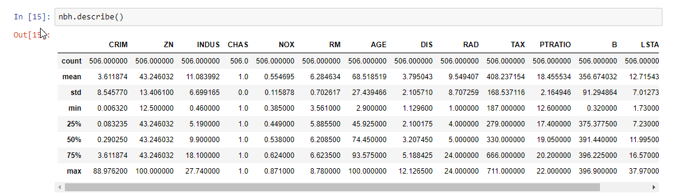
CLEANING DATA COMPARISON
RAW DATA
CLEAN DATA
C

Slide 12

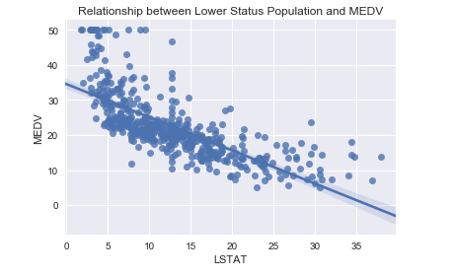
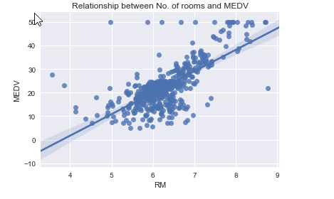
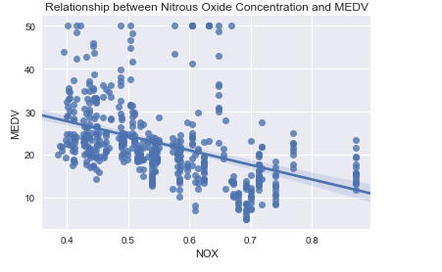
Shapes To Explain Ideas
VISUALS
BETWEEN ‘NOX’ AND‘MEDV’.
VISUALS
BETWEEN ‘LSTAT’
AND ‘MEDV’.
VISUALS
BETWEEN ‘RM’
AND ‘MEDV’.

Slide 13
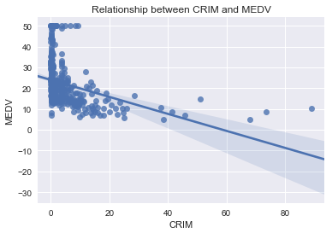
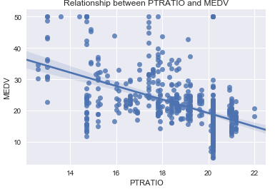
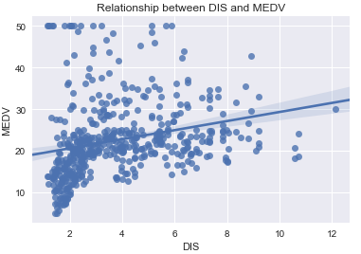
Shapes To Explain Ideas
VISUALS
BETWEEN ‘DIS’ AND‘MEDV’.
VISUALS
BETWEEN ‘CRIM’
AND ‘MEDV’.
VISUALS
BETWEEN ‘PTRATIO’
AND ‘MEDV’.

Slide 14
The Process
SCATTER PLOTS
HISTOGRAMS
R*2 EVALUATION

Slide 15
FEATURE OBSERVATIONS
RM EFFECTS
LSTAT
PTRATIO
NOX CONTENT
AN INCREASE IN THE ‘RM’ VALUE LEADS TO INCREASE IN THE VALUE OF ‘MEDV’ AS MORE NO.OF ROOMS COULD RESULT IN THE INCREASE IN PRICE.
AN INCREASE IN LSTAT VALUE WOULD ALSO LEAD TO HIGHER ‘MEDV’ VALUE. AS HOMEOWENERS WITH GREAT NETWORTH WOULD CAUSE HIGHER PRICE OF THE HOUSE
IF THERE ARE MORE NO.OF STUDENTS THAN TEACHER,THEN IT DECREASES THE QUALITY OF EDUCATION AND THUS DECREASES THE PRICE OF HOUSES
MORE CONCENTRATION OF NIRTOUS OXIDE IN THE ATMOSPHERE WILL ALSO DECREASE THE PRICE OF THE HOUSES.
CRIM
R SQUARE CALCULATION
CRIME RATES IS ONE THE MAJOR FACTOR CONSIDERED FOR PRICE PREDICTION.IF HIGHER CRIME RATES,THEN DECREASE IN PRICE.
R-SQUARE VALUE IS THE PREDICTION VALUE OF THE LINEAR REGRESSION FOR THE MODEL.HERE DATA IS TRAINED FOR OBTAINING HIGHER R2 VALUES.

Slide 16
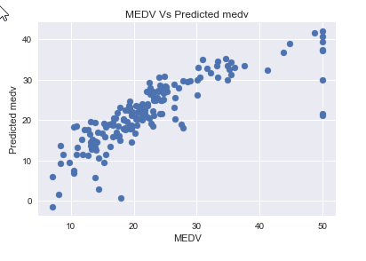
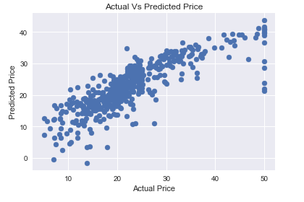
RESULTS AFTER TRAINING THE DATA

Slide 17



INSIGHTS
The model can make consistent predictions based on some sets of dataset but may also produce inconsistent predictions on other data sets. So, there is a variability in the predictions.
THE R-SQUARED VALUE FOR THE RAW DATA WAS 0.69584.
The features present in the data is not sufficient enough to describe a home because there can be many more factors affecting the prices of the house. It may be helpful to make use of information such as the neighbourhood the house is in, the year the house was built, the size of the lot, etc.
THE R-SQUARED VALUE AFTER TRAINING THE DATA IS 0.8856.
FROM THIS WE CAN CONCLUDE THAT OUR PREDICTION IS QUIET GOOD

Slide 18
Thank YOU!
You can find me at:
Johnaki.777@gmail.com

